Slide 1
Efficient Content Reuse in Structured Documentation

Slide 2
PROBLEM STATEMENT
USE-CASE
KEYWORD similarity
KEYPRASE similarity
SENTENCE LEVEL similarity
PARAGRAPH LEVEL similarity
1.Automated Content Referencing in Technical Documents.
2.Intelligent Migration of legacy content to structured format
Notes:
Content reuse is being done on similar content only.These are the various state of art techniques which are being deployed to fulfill our use cases.
Which are :

Slide 3
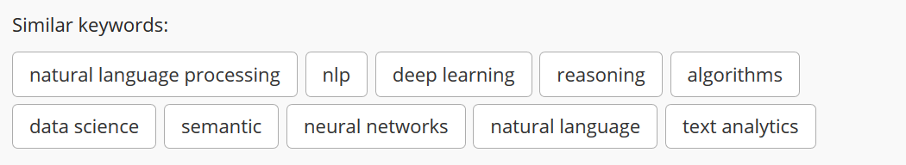
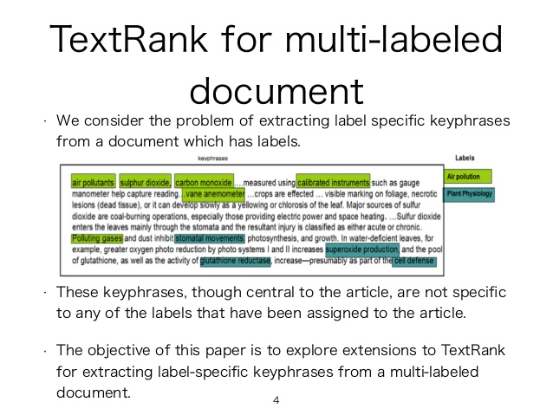
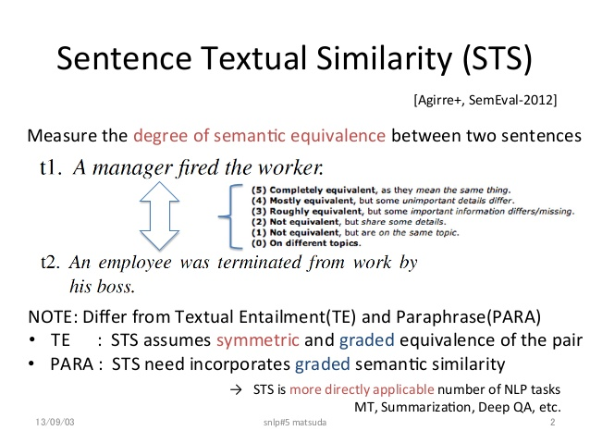
UNDERSTANDING PROBLEM STATEMENT
KEYWORDS
KEYPHRASE
SENTENCE LEVEL
PARAGRAPH LEVEL
Notes:
Content reuse is done on similar content only.
So , the various levels which we will be covering while finding the similarity of texts.
As the levels increases, the complexity also increases.
Ie , The complexity for finding semantic equivalence increases.

Slide 4
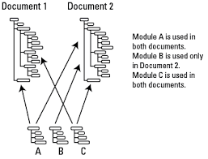
UNDERSTANDING USE-CASE
Content Referencing via CONREF and CONKEYREF can be :
Intra- Document.
Inter-Document inside the same platform.
“15% of the overall body of technical content could be sourced from other technical content by reuse, that saves 15% of the overall budget for
brand content creation, review and translation”
Notes:
So, the feature of Conref and Conkeyref provided by DITA.
Ie , same content can be reused in the same document.
2. Same content can be use in different documents .
3. Third , Efficient reuse of technical documents in the marketing space.

Slide 5
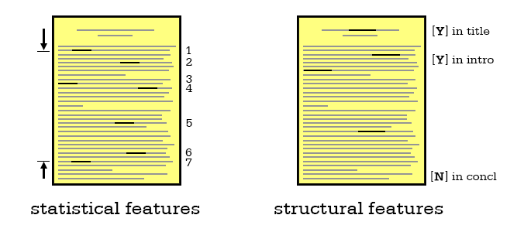

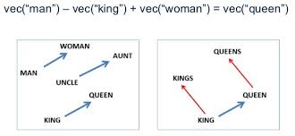
OUR MODEL
FOR KEYWORD AND KEYPHRASE LEVEL
WORD EMBEDDINGS
(WORD2VEC Model.)
(GLOVE Model.)
USER CLICKS
ANALYTICS
Grammar Rules
Notes:
Right now , we have completed upto.
Keyword and keyphrase level.
Statistical features-> frequency count, len_phrase
Structural-> title intersection, distance of the phrase from the start.
Grammar rules -> How the Part of speech tags of words constitutes a phrase
Word embeddings-> a way to convert words into vectors.
User click analytics

Slide 6


Workflow of Key phrase Extraction
Grammar Chunking
Naïve Bayes Classifier
Candidate Key phrases
Preparation of Attribute values of Candidate Key phrases
User
Filtered Key phrases
User select key phrases from the filtered Key Phrases
Training the classifier again based on User Selected Key phrases.

Slide 7
How this key phrase Extraction works?
Grammar Chunking
Adobe Experience Manager
POS Tagging
grammar["NNP->NNP"] = "NNP"
grammar["JJ->NNP"]="NNP"
grammar["NN->NN"] = "NNI"
grammar["NNI->NN"] = "NNI"
grammar["JJ->JJ"] = "JJ"
grammar["NNP->NN"]="NNP"
grammar["CD->NN"]="NN"
grammar["NN->CD"]="NNP"
grammar["NNP->CD"]="NNP"
grammar["CD->NNP"]="NNP“
(Grammar that we used)
Proper Noun(NNP)
Common Noun(NN)
Common Noun(NN)
(Selected as Candidate Key phrase)

Slide 8
How this key phrase Extraction works?
Attributes Preparation
Term Frequency
Distance of the phrase
Title Intersection
Relatedness to other Candidate Key phrases.
POS tags used in the key phrases.
POS tags used for words before and after the Candidate Key phrase.
“Computer Vision” -> 3,82,0.05555555555555555,1,1,0,0,0,0.264112995006

Slide 9
How this key phrase Extraction works?
User Click Analytics
User selects Key phrases for the Documents.
Attributes for the User Selected Key phrases are fed back to Naïve Bayes.
Attributes for User Selected Non key phrases are also fed back to Naïve Bayes.
Helps in Training the Naïve Bayes Classifier.

Slide 10
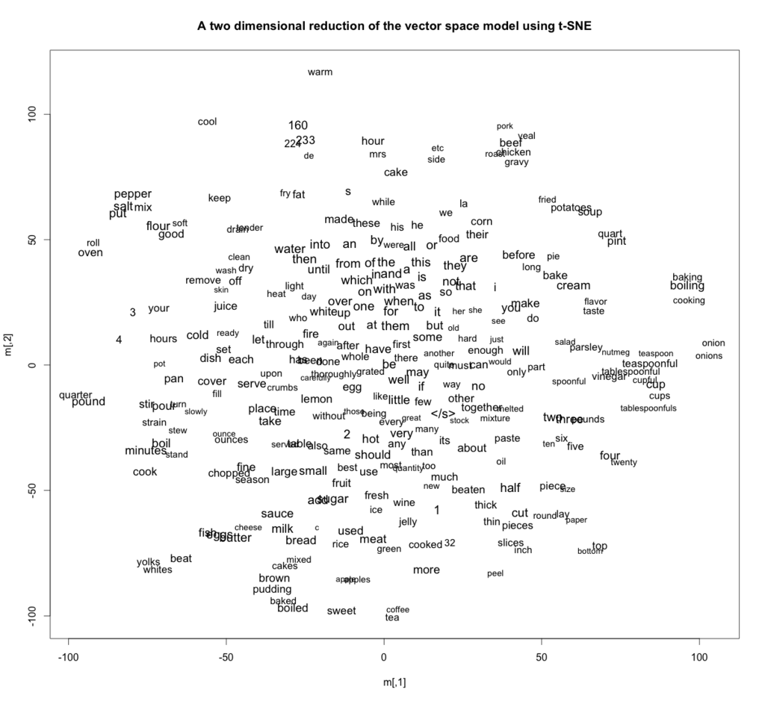
WORD2VEC
“You shall know a word by the company it keeps” (Firth, J. R. 1957:11)
W("cat")=(0.2,−0.4,0.7,...)
W("mat")=(0.0,0.6,−0.1,...)

Slide 11
Similarity of User Selected Key phrases
Adobe Private Limited Systems.
Adobe Systems
Conref/ConkeyRef should be done.
Due to the small size of Key phrases, Weighted Word2vec Average Works Fine and is computationally less expensive than sequential models.
“King” – “Queen” + “Woman” is nearly equal to “Man”
Semantic similarity of key phrases is also captured.
Threshold of Similarity is decided based on User’s decision to Conref or not.

Slide 12
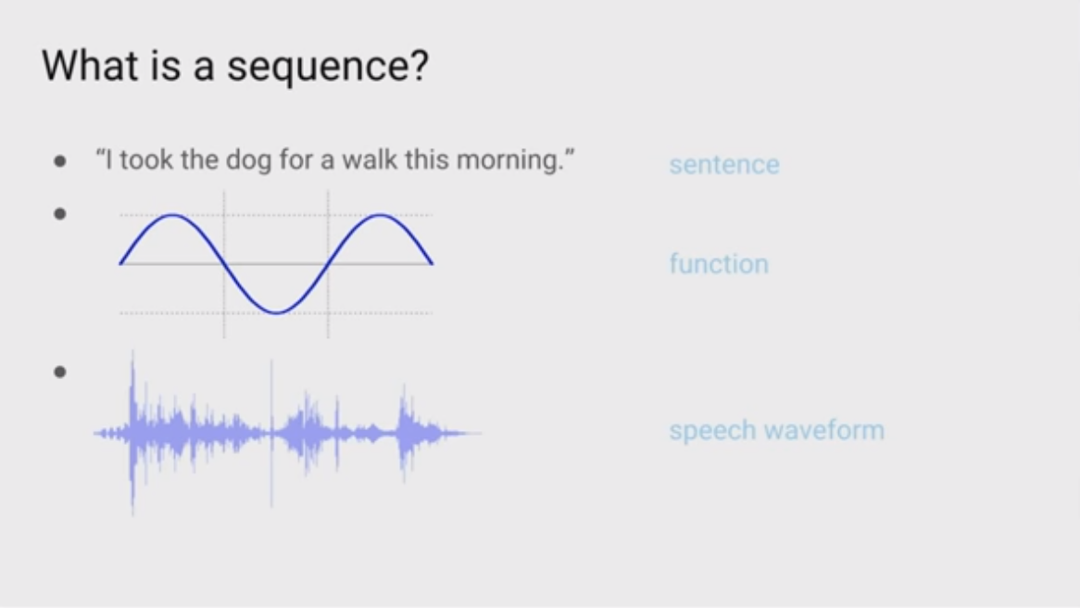
Sentence Similarity
For comparing Sentences, we need to convert a sentence into Vector.
Have to treat sentence as a sequence which gives a single meaning , instead of treating it as sum total of scattered meaning of words.

Slide 13
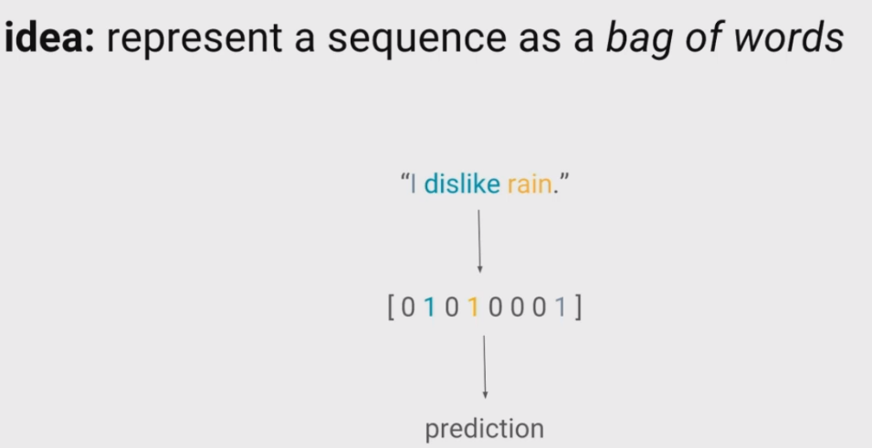
Sentence Similarity
Doesn’t preserve the order of the words.
Sum total of scattered meaning of the words in the Sentence.
Sentence 1: “The food was good, not bad at all”
vs
Sentence 2 : “The food was bad , not good at all”
Weighted word2vec Average of words
Notes:
Quite equivalent to match words in 2 sentences.

Slide 14
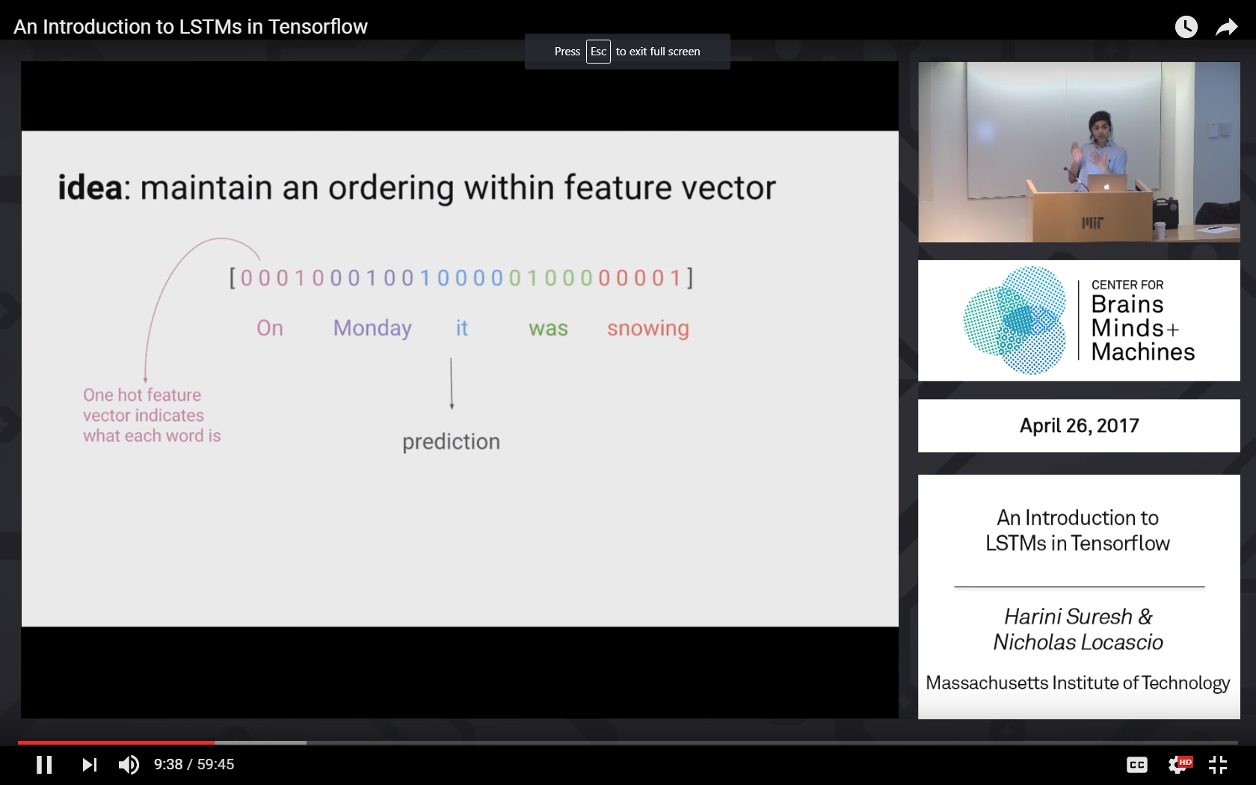
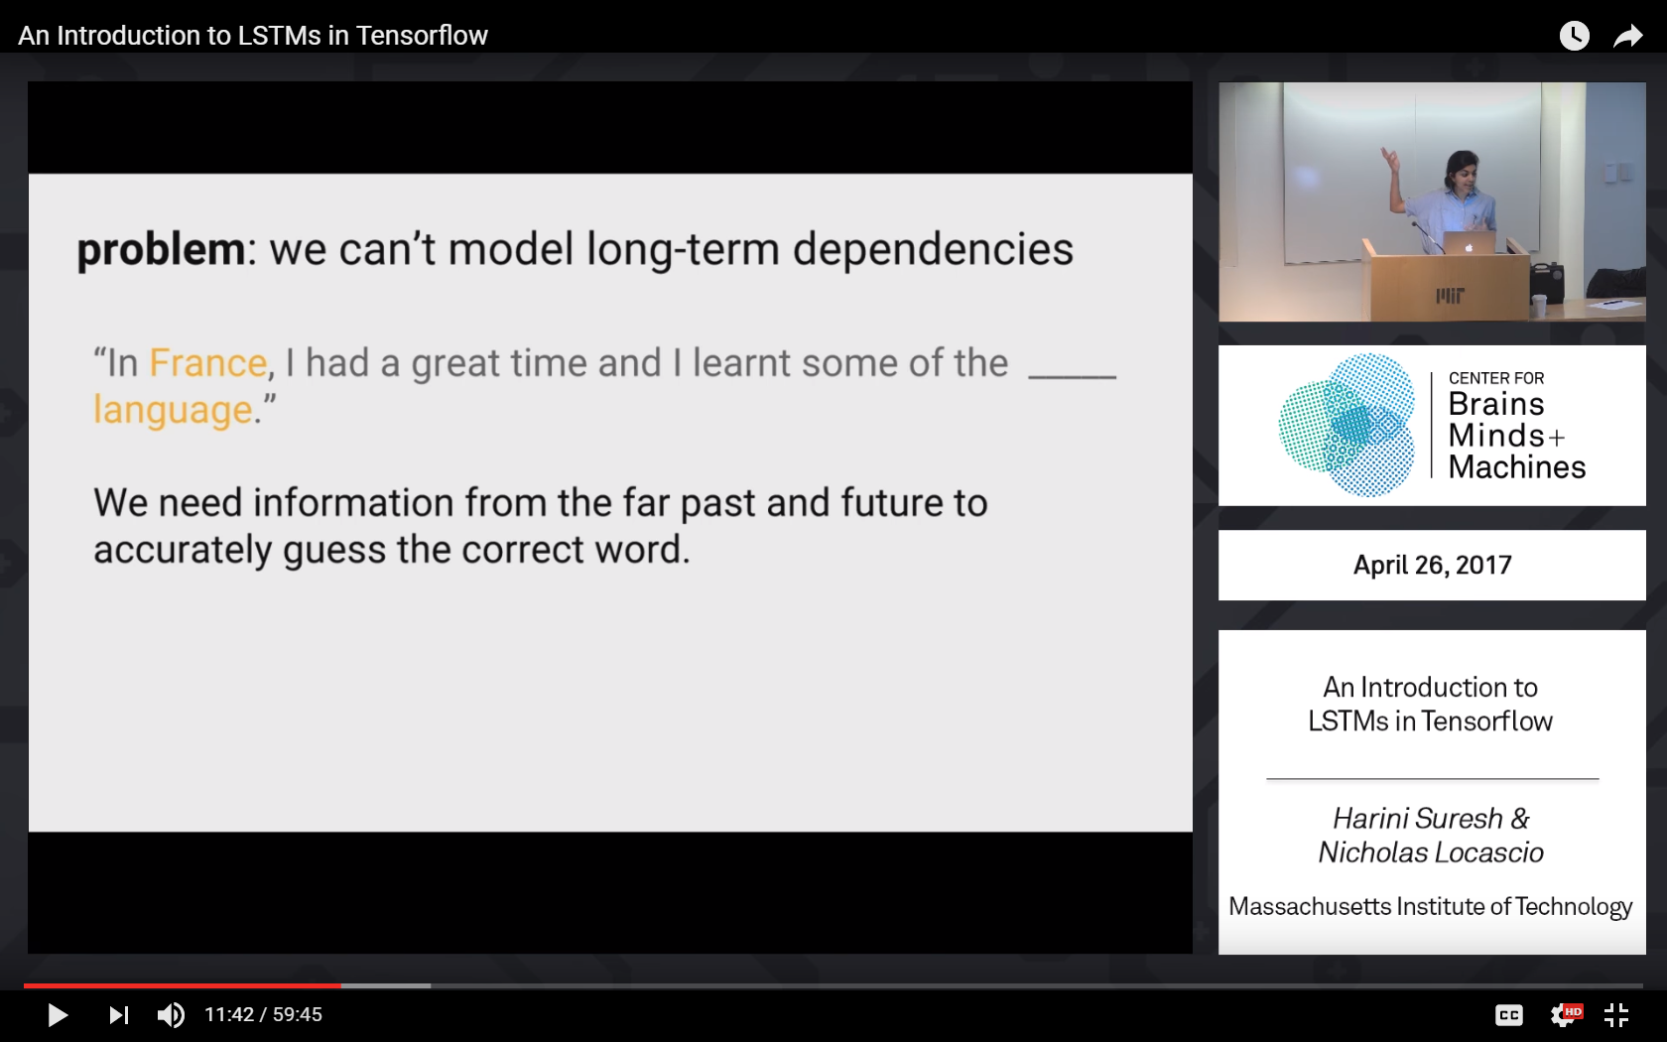
Sentence Similarity
Sentence 1: On Monday , it was snowing.
VS
Sentence 2: It was snowing on Monday.
Can’t model Long term dependencies

Slide 15
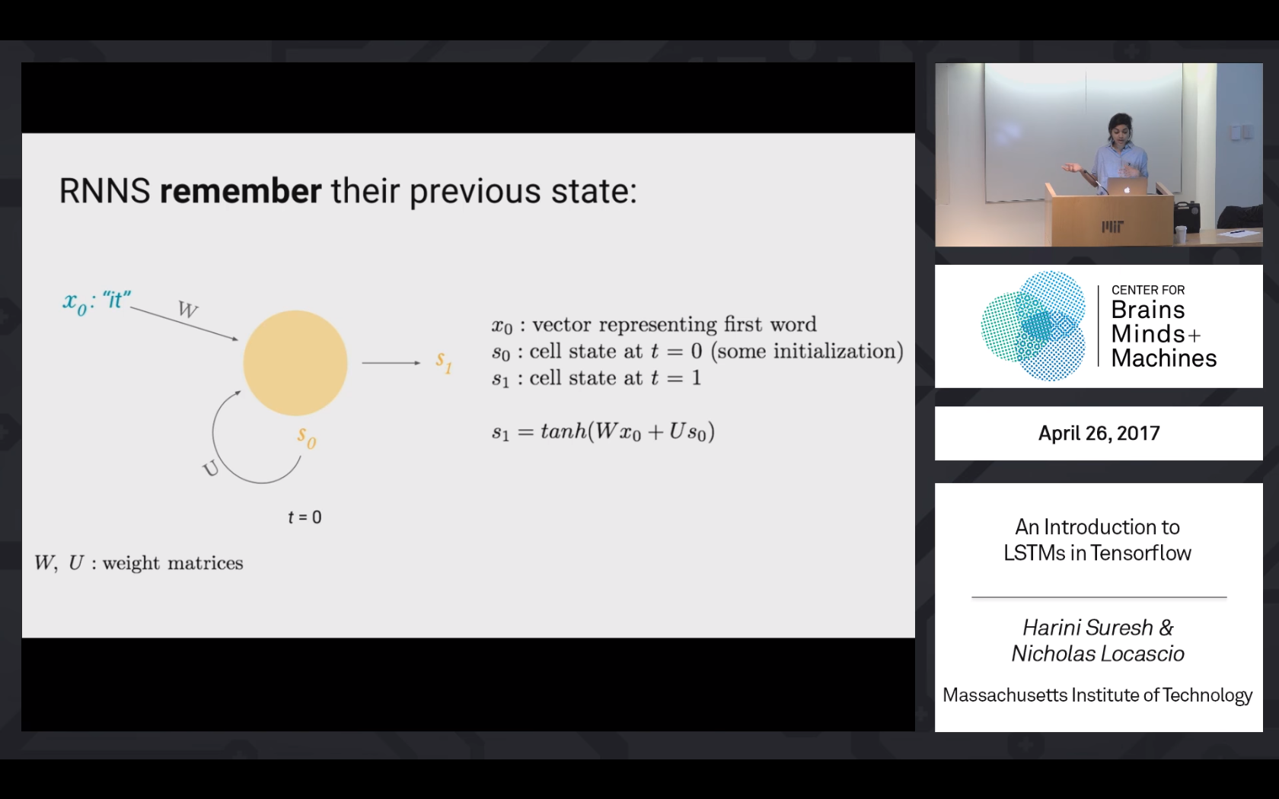
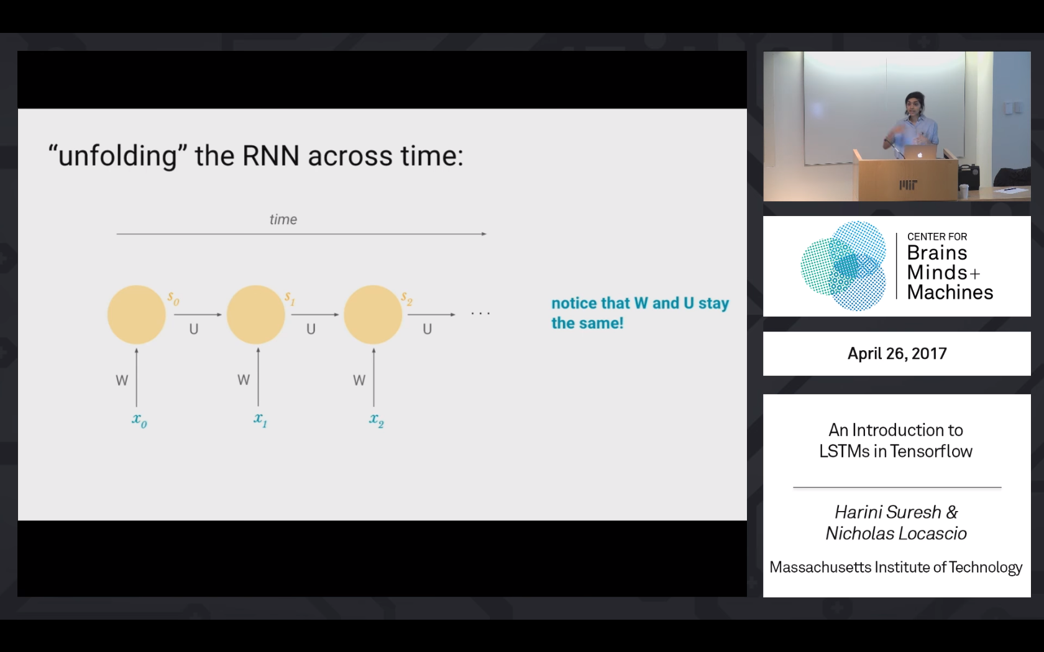
Sentence Similarity (Skip Thought vectors)
Bidirectional Gated Recursive Neural Networks
S(t)= S(t-1)*U + W*xt
Notes:
Captures the essence of how we comprehend a sentence.

Slide 16
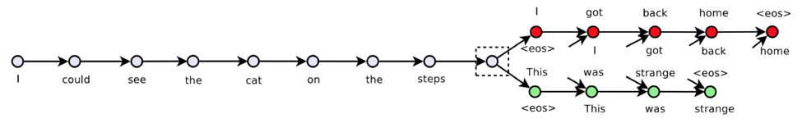
Skip Thought vectors
Encoder Decoder Network
Uses Backpropagation Through Time,
To adjust weights of all RNN.
Maintains word Order.
Shares Parameters across the Sequence unlike other models.
Keep tracks of Long term dependencies.
Notes:
AI Writer.
Andrej karpathy Shakespeare writing rnn.
Machine translation

Slide 17
Some Results of Skip Thought vectors
﻿key phrase provides highly-summative information that can be effectively used for understanding, organizing and retrieving text content.
90%
high-quality key phrases can facilitate the understanding, organizing, and accessing of document content.
87%
he ran his hand inside his coat , double-checking that the unopened letter was still there .
he slipped his hand between his coat and his shirt , where the folded copies lay in a brown envelope
Threshold for sentence similarity will be adjusted according to User’s action of Linking the sentences.
Notes:
One modification that we can do, is train this skip thought vectors on Contents which are specific to a company’s domain . Right now it’s trained on 11,000 novels.

Slide 18
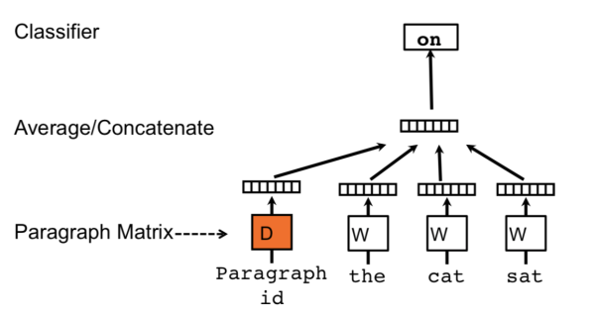
Paragraph Similarity
Problems with Paragraph vectors in our Use Case.
Overfitting.
Performs bad when paragraphs are of varying length.
Hyper tuning of parameters have to be done properly.(eg . Min count parameter )
Paragraph Vector
Problems with Skip Thought vectors .
Skip thought vectors couldn’t replicate the results at paragraph level because of long term dependencies problems( Vanishing Gradient Descent)
Skip Thought Vectors

Slide 19
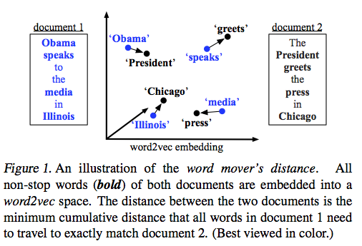
Paragraph Similarity
Word Mover’s Distance

Slide 20
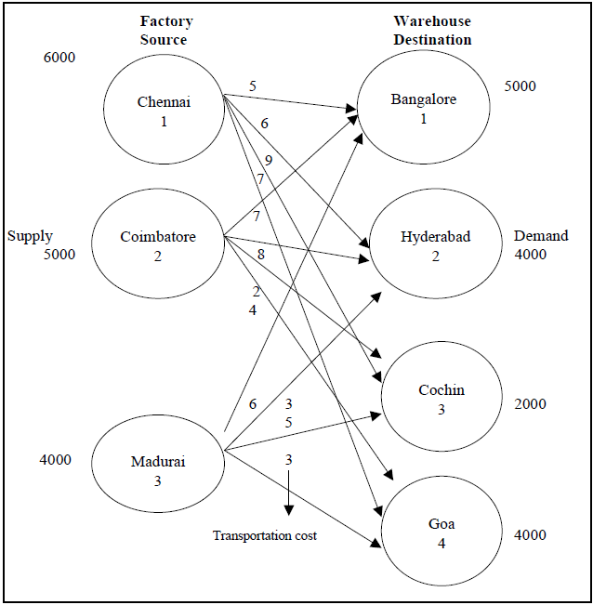
Paragraph Similarity
The Paragraphs are represented as collection of Words and Using word2vec Embeddings, distance between words are calculated.
Objective of WMD is to determine the minimum distance the words of Para1 needs to travel to reach to the same state represented by the words of Para2.
Distance in between Paragraphs
Similarity between Paragraphs
Transportation Problem

Slide 21
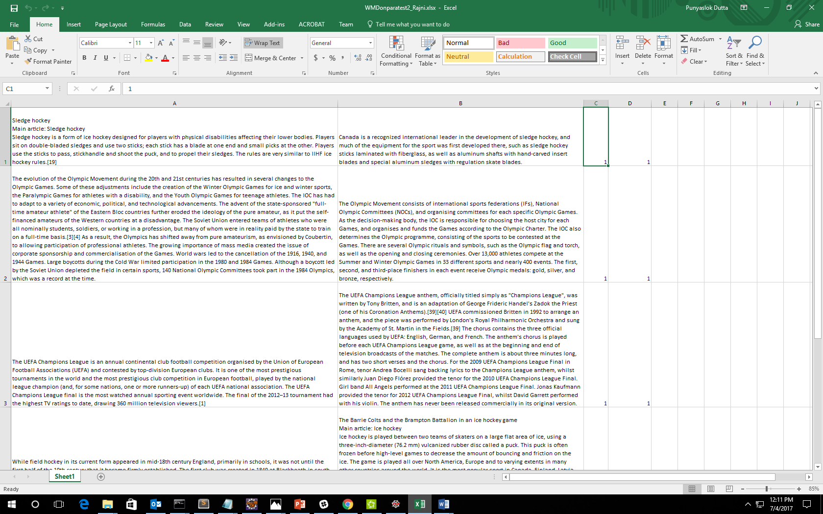
Results of WMD on Paragraph Similarity
Accuracy =79%
F1 score =0.81
Precision=0.74
Recall=0.90
Hyperparameter free

